Slide 1

Data Pipeline for MMA
BY: MIguel Lopez

Slide 2
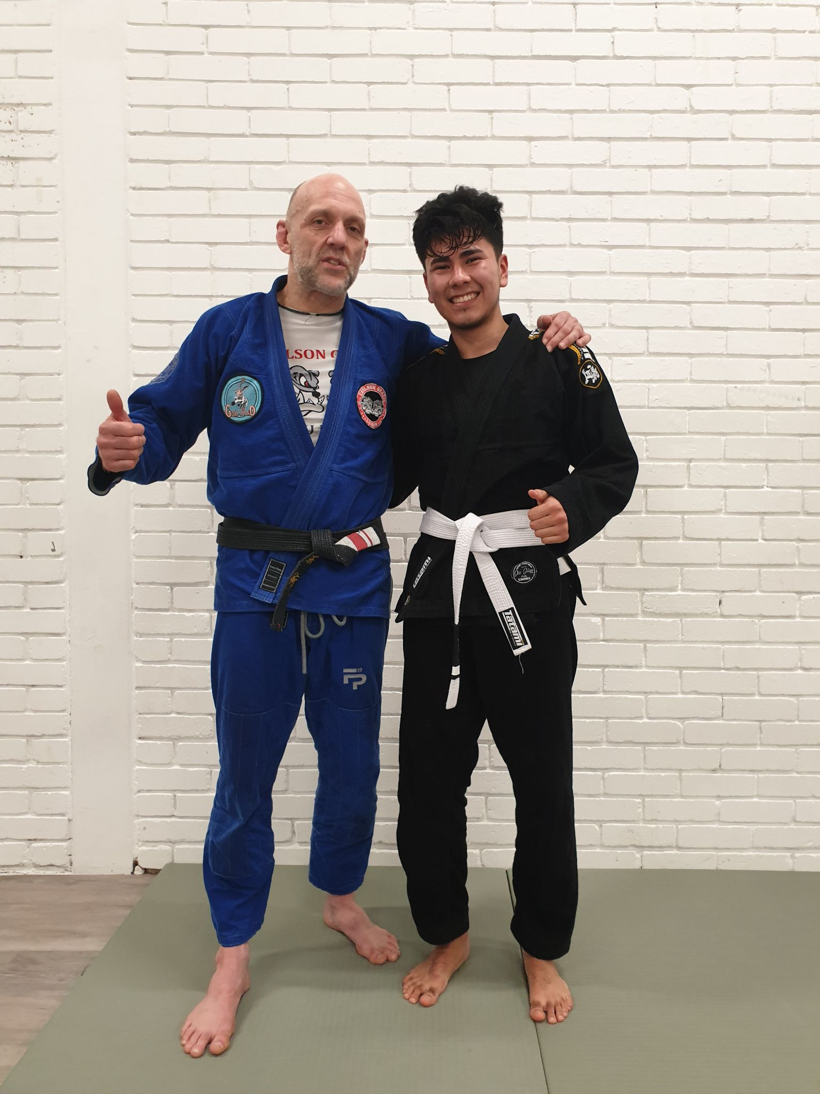
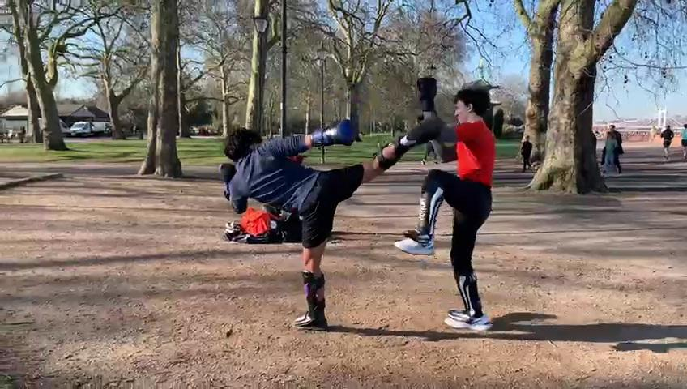
Motivation:
I train in MMA. I lose. I want to win. Use all of my skills and attributes.
Max Holloway Featherweight champion doesn’t spar but plays UFC.
The aim of this project is to scrape the data found on UFC's stat website, clean it and store on an AWS's RDS.
Which will later be used in making a model to come up with the most efficient way of fighting depending on your opponent's style.
Allow us to visualise the development in technique for MMA over the years.

Slide 3
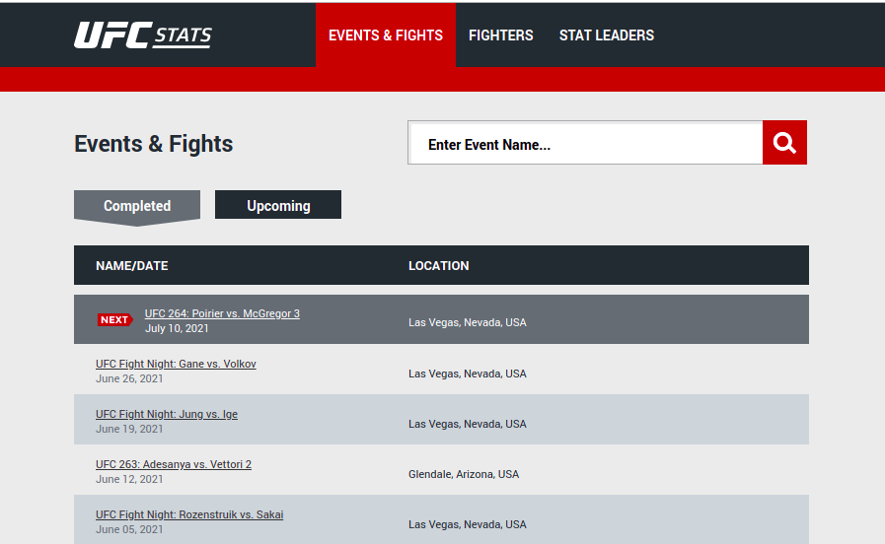
Where I got my data from?
From the UFC’s official website.
Greatest history
Well documented
Consistent

Slide 4
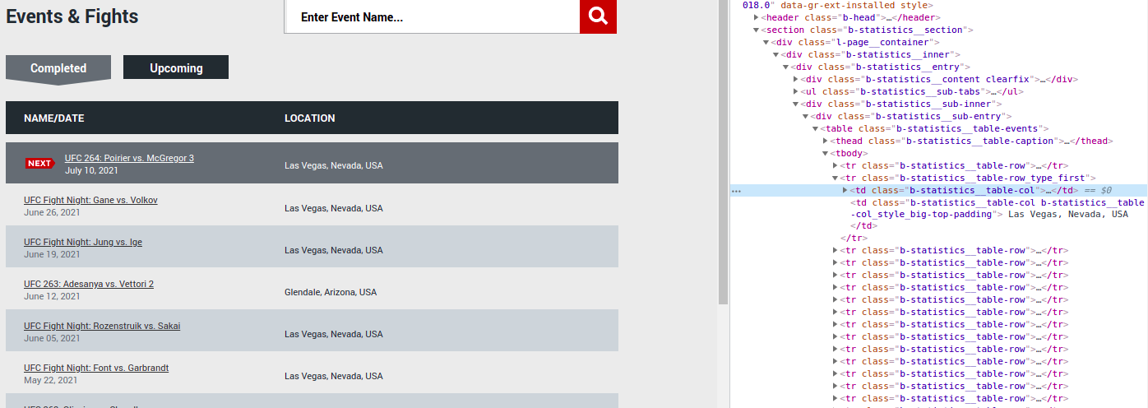
Layout example:
Events page
Finds the links to fight night event in the main table.
Accessed via selenium, using tags to access table containing links with tag a and href attribute.

Slide 5
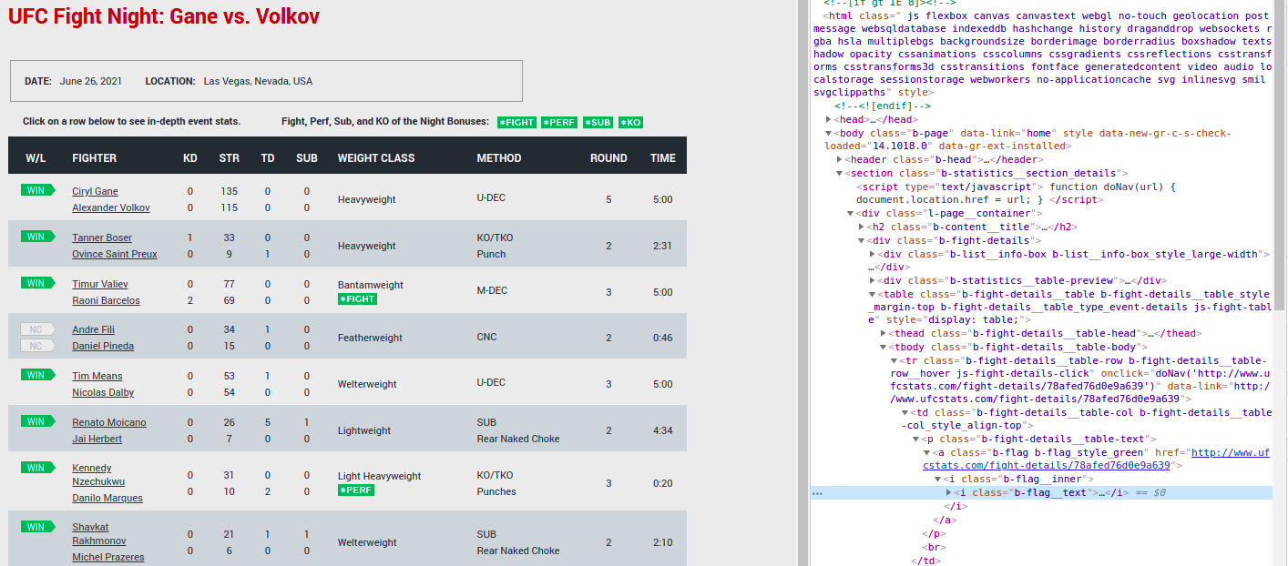
Layout example:
Fight Night
Find the links in the page. To then access the stats of that fight.

Slide 6
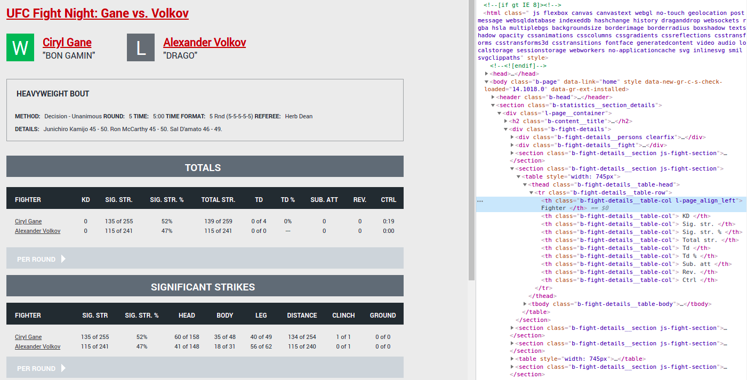
Layout example:
Fight stats
Scrapes the data of tables and stores them according to fighter and type of data.

Slide 7
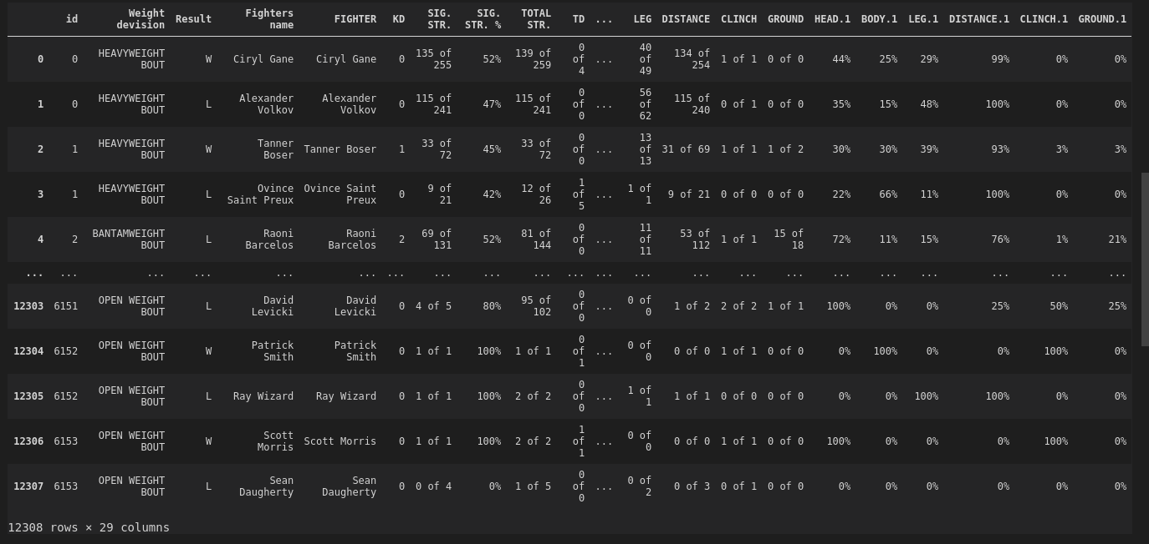
Cleaning process and adding it to AWS RDS
Dataframe was built as the websites containing the fight stats were scraped.
Checked for unique values, duplicates and errors before storing.
Once the dataframe was built used pd.to_sql to upload to database
Try and except.

Slide 8
Storage type:
Data warehouse - AWS RDS
The data was stored in AWS’s RDS with Postgres.
Python sqlalchemy.
Each key is linked to a particular fight.
The time allows us to see how fighting in MMA evolved.

Slide 9
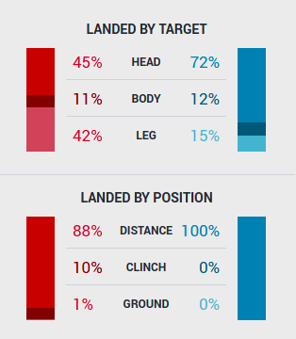
Variables to be used in predicting a fight strategy
First we will need to categorise the fights into weight class.
From the weight-class we can then find out which method of striking and body location most likely results in winning.
Find the fighter height and weight.
Then do the same for grappling stats.
Compare the relative success of the two.
What is better? More grappling or striking. Which method of grappling and striking is best?
Predict the result of fights that never happened?!

Slide 10
Greater predicting power
Use:
Boxing data
Kickboxing
Judo
BJJ

Slide 11
Questions?
Please ask!

